Slide 1

Turning audio into intelligence

Slide 2
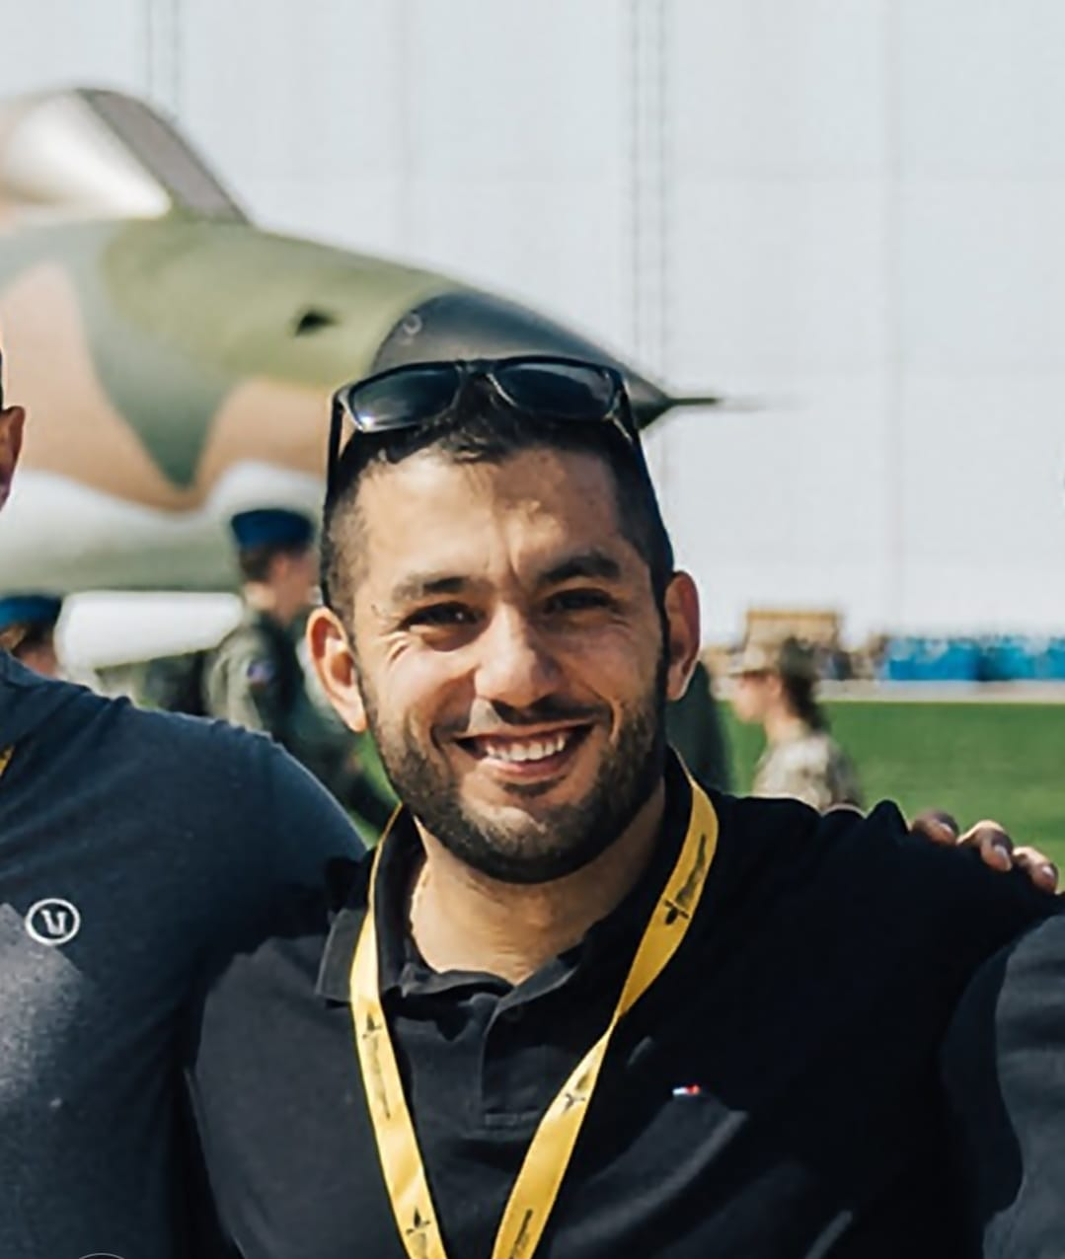





Who We are ?
Ramy
Tobias
Vasiliy
Asyl
Alexander

Slide 3
The problem
Too much noisy data BUT not enough resources
Underlevergaged to gain real isnigt
Current SIGINT tools focus on what is said, not how or where.
Lack of automation slows tactical decision-making in fast-changing environments.

Slide 4
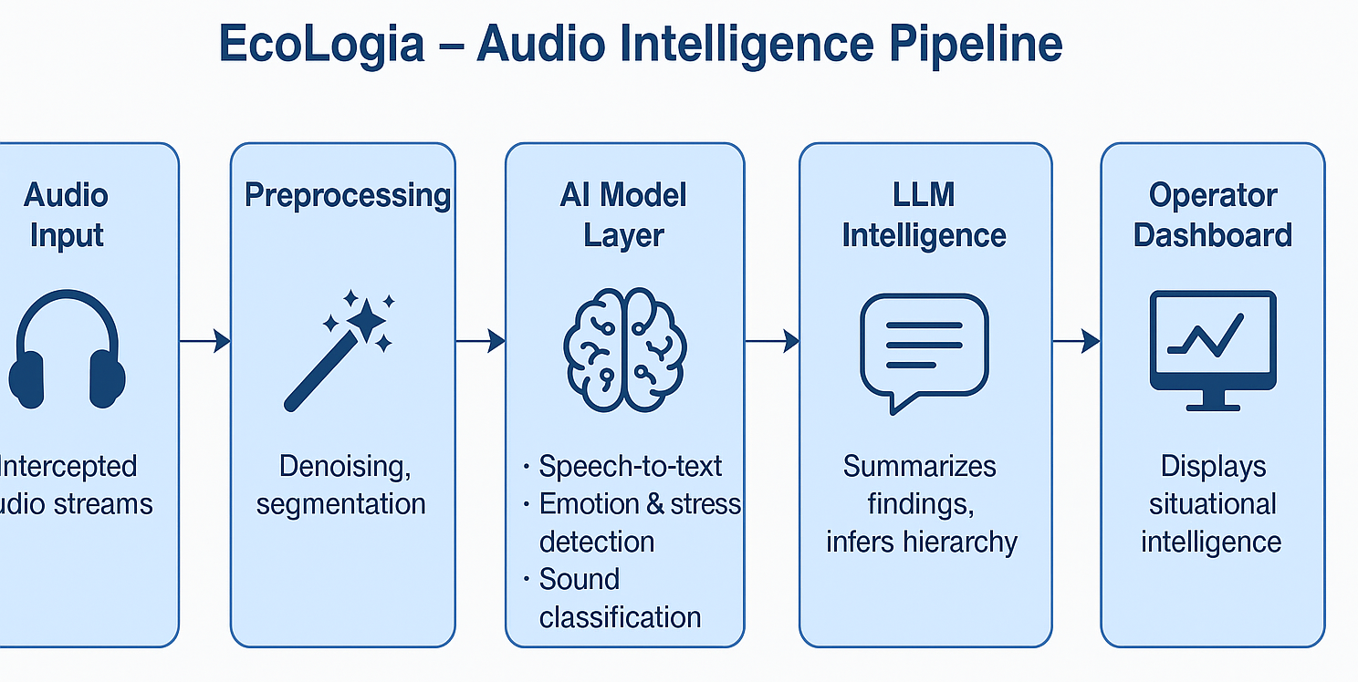
How we solve this?

Slide 5
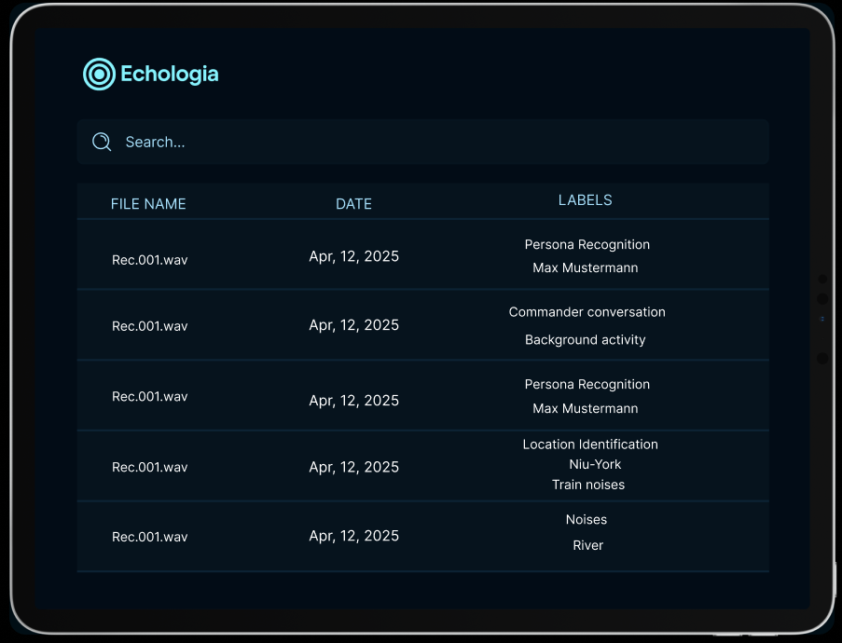
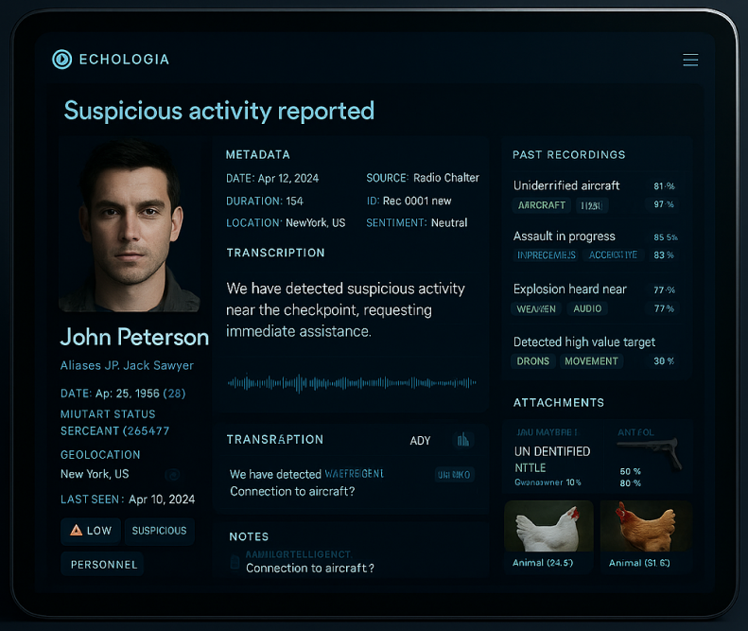
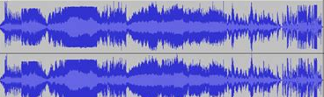
How it looks like?

Slide 6
Hackathon Achievements
Prototype built integrating Whisper + LLM for multi-layered audio intelligence.
Visual concept mock-up + backend logic diagram.
Team collaboration on multimodal AI integration.

Slide 7
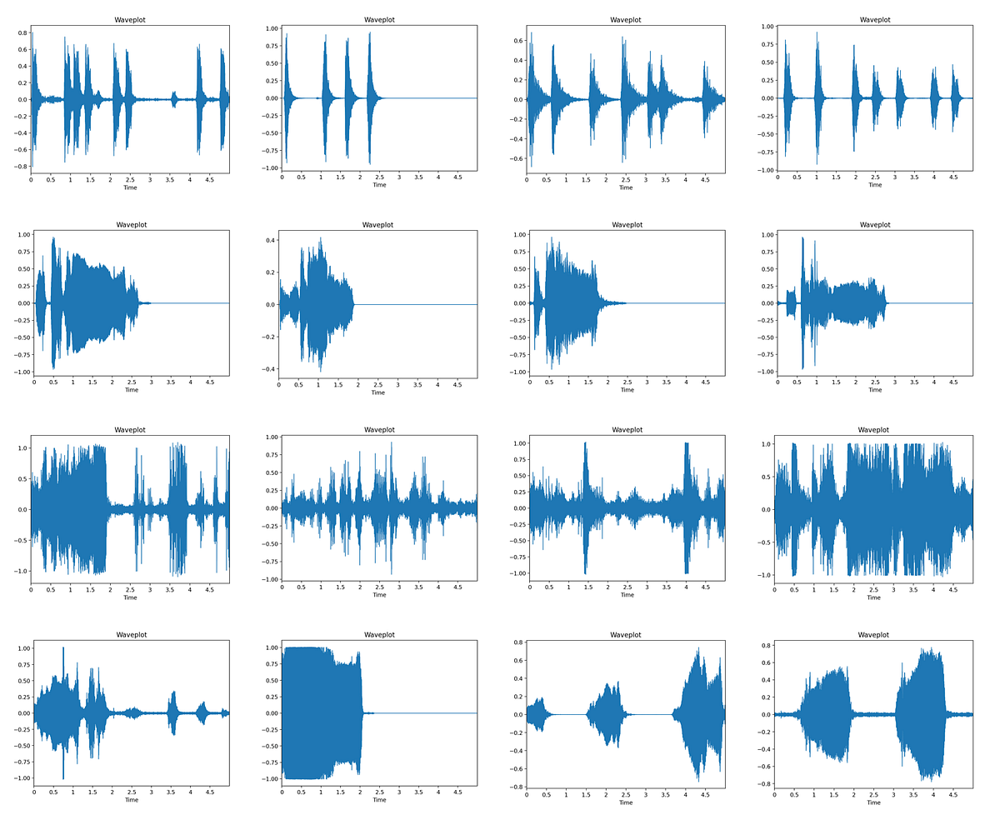
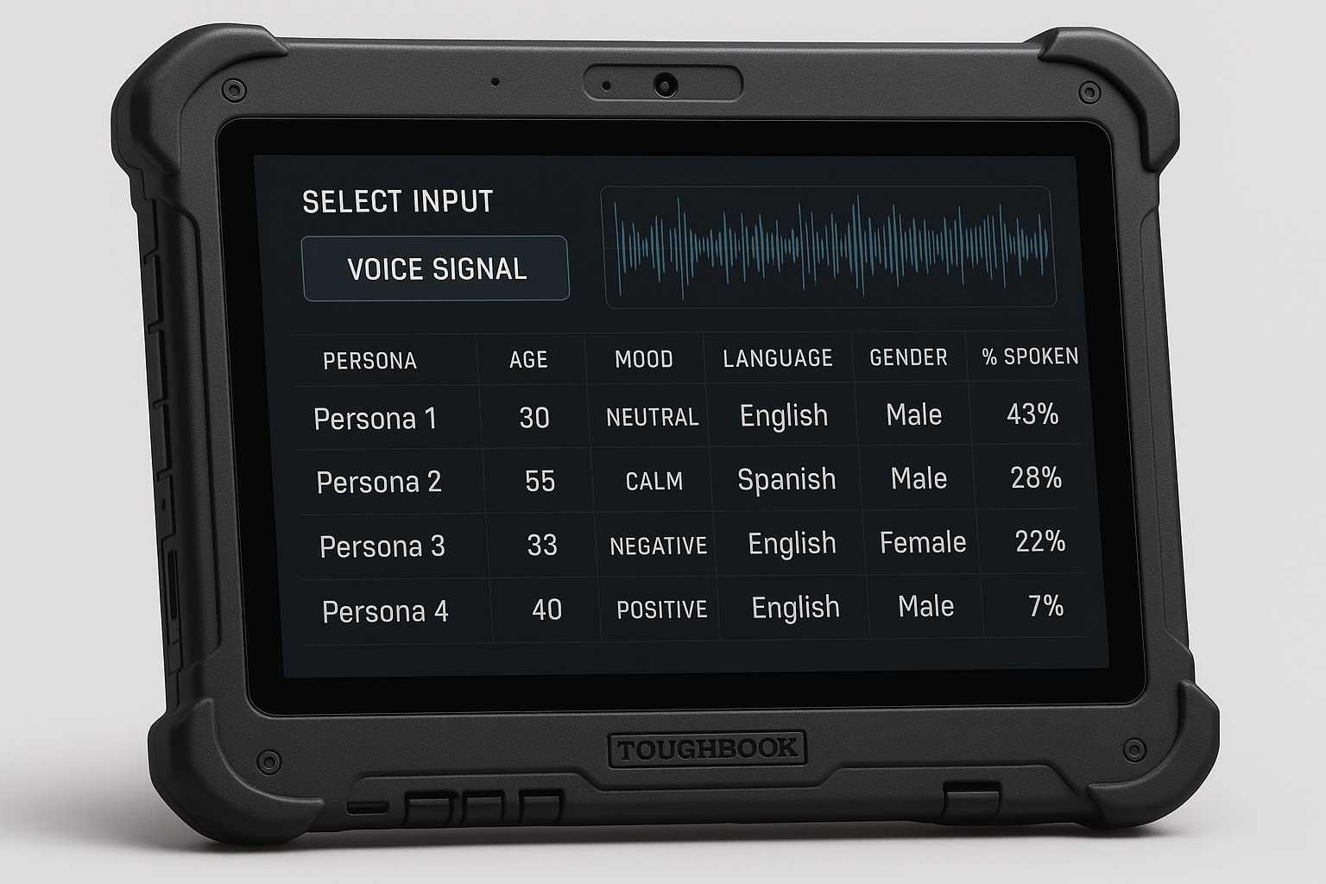

What to do next?
Real data from real world
POC
Scale

Slide 8
Deployment & Scale
Runs on field-deployable devices (e.g., Panasonic Toughbook).
Modular backend for integration into NATO ISTAR or civilian emergency systems.
Scalable cloud / edge architecture.
Designed for secure environments (air-gapped or encrypted networks).
Potential for dual-use: defense, disaster response, intelligence fusion

Slide 9
Turning audio into intelligence
Ramy
Tobias
Vasiliy
Asyl
Alexander

